Slide 2
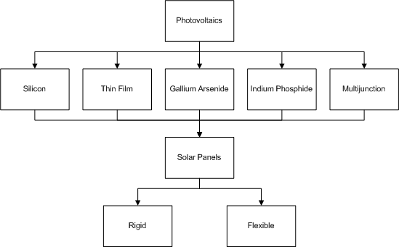
Electrical Power System
Pruned design option Tree
Two candidates: Thin film and
Triple-Junction

Slide 3
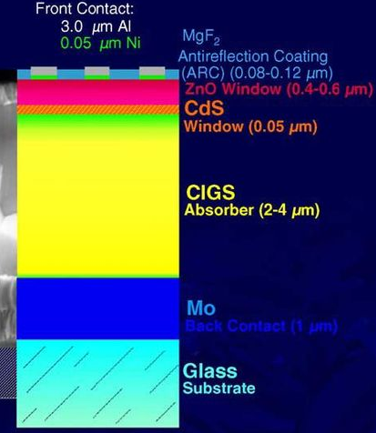
EPS – Thin Film CIGS
Multiple layers of thin
photovoltaic material
Copper-Indium-Gallium-Selenium
absorber
Low efficiency
Low production cost
High absorptance coefficient

Slide 4
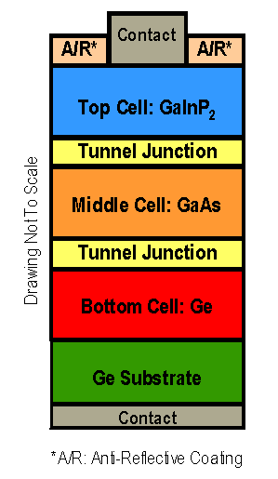
EPS – Triple Junction
Multiple pn-junctions
High efficiency
High production cost
Larger covering of solar spectrum

Slide 5
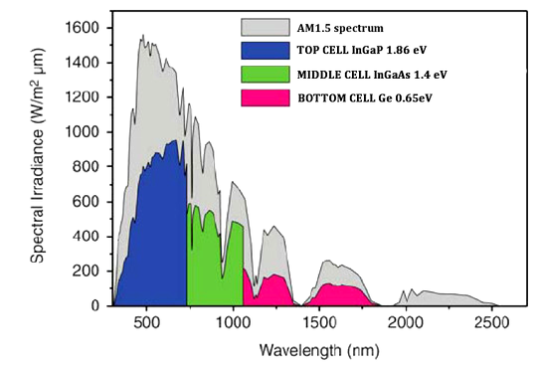
EPS – Triple-Junction

Slide 6
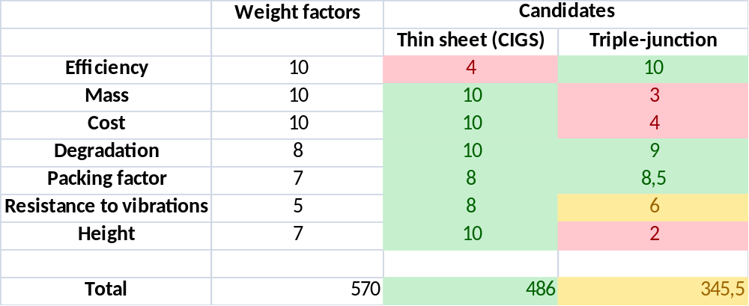
EPS – Trade-off
Trade-off summary table:

